Slide 1
EDES 301 <Eggcellent Timer> Proposal
<09.30.24>
<Sumin Jeong>

Slide 2
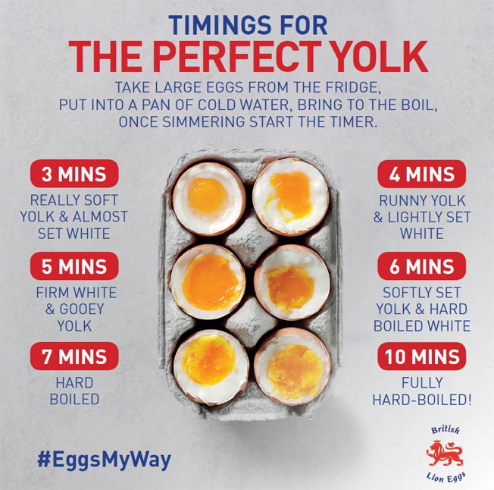
Background Information
Egg cooking timer
There are buttons for each timer, depending on the degree
of how much you want the egg to be boiled
Ex) 6 min button for soft yolk, 10 min for fully hard-boiled, etc.
Temperature sensor: informs the temperature of water
IR break beam sensor: tells when to put in the egg
There is a display that shows the timer counting down and the
water temperature
Buzzer alarms when it is done cooking
In terms of how the device would look like, I got motivation from this project:
https://www.hackster.io/sp94/engi-301-sunrise-alarm-clock-e4a65d

Slide 3
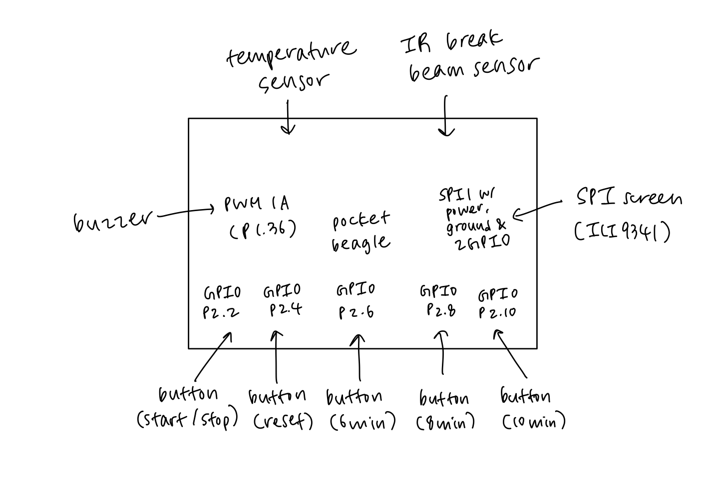
System Block Diagram

Slide 4
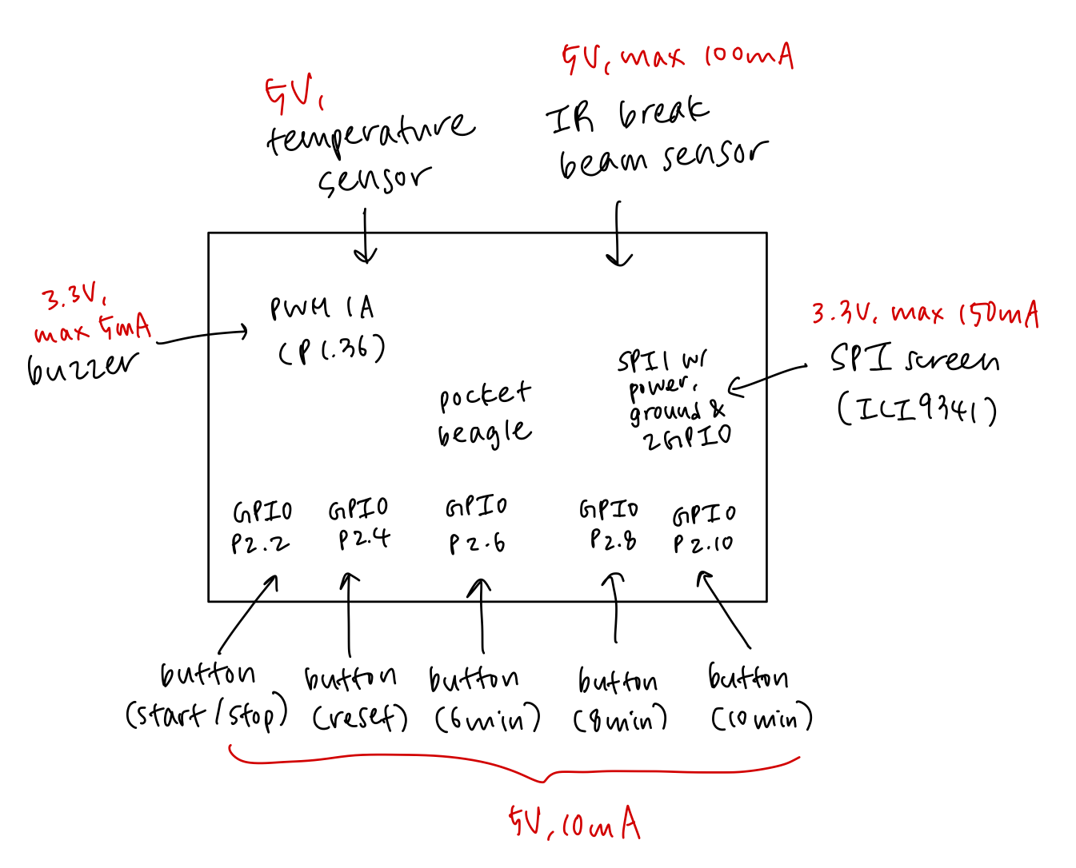
Power Block Diagram

Slide 5
Components / Budget
Component | EDES301 to Buy? | Cost
1x LCD Touchscreen (https://www.adafruit.com/product/1770) |  | $29.95
1x Buzzer (https://www.adafruit.com/product/1536) |  | $0.95
5x Arcade buttons (https://www.adafruit.com/product/3491) | Yes | $12.50
Temperature sensor (https://www.amazon.com/Gikfun-DS18B20-Waterproof-Digital-Temperature/dp/B08V93CTM2) | Yes | $13.48
IR break beam sensor (https://www.adafruit.com/product/2167) | Yes | $2.95

Slide 6
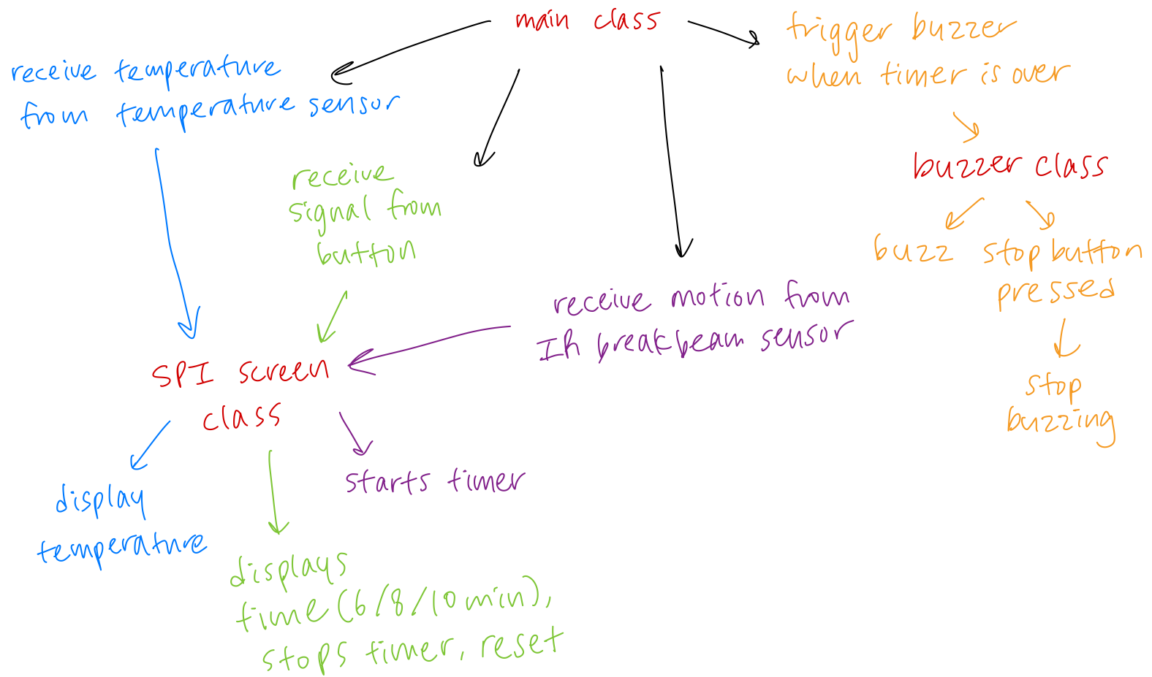
Software Block Diagram

